Slide 1

Working towards an accurate Credit Score Model
Credit One – November 2020

Slide 2

1
PROJECT OBJECTIVE
01
Goal and deliverable of the project
2
DATA SCIENCE PROCESS FRAMEWORK
02
Approach and structure to follow
3
DATA SOURCES
03
AGENDA SLIDE
Description and location of the data
4
DATA MANAGEMENT
04
How data would be managed
5
POTENTIAL ISSUES
05
Data issues and suggested treatment
6
DATA INSIGHTS
06
Data issues and suggested treatment

Slide 3

PROJECT OBJECTIVE

Slide 4
Project Objective
Credit One
PROBLEM STATEMENT
Over the past year or so Credit One has seen an increase in the number of customers who have defaulted on loans they have secured from various partners, and Credit One, as their credit scoring service, could risk losing business if the problem is not solved right away.
PROJECT OBJECTIVE
Develop, design, and implement a solution that accurately predicts and classifies if an individual will default or not on a given loan

Slide 5

DATA SCIENCE PROCESS FRAMEWORK

Slide 6
DATA SCIENCE PROCESS FRAMEWORK
6 STEP CYCLE APPROACH
DEFINE THE GOAL
COLLECT & MANAGE DATA
01
Define a measurable and quantifiable goal.
Identifying, exploring, and conditioning the data needed.
06
02
BUILD THE MODEL
EVALUATE & CRITIQUE MODEL
Extract useful insights from the data in order to achieve goals..
Determine whether the model meets the project goals.
05
03
PRESENT & DOCUMENT RESULTS
DEPLOY & MAINTAIN MODEL
Present results to project sponsor and stakeholders.
Deploy the model, confirm performance, fix bug, and add feedback
04

Slide 7
DATA SCIENCE PROCESS FRAMEWORK
PROJECT ANALYSIS
DEPLOY & MAINTAIN TOOL
DESIGN THE GOAL
Need to be a documented product
Post implementation support provided
Review and update model
Goal stated before
Current solution is not working
Need: accurate database to work on
Review current model & methodology
PRESENT & DOCUMENT RESULTS
COLLECT AND MANAGE DATA
Should avoid using the tool in a vacuum
Business context and acumen in combination of the model is key
Available data seems enough, but additional consumer data would be beneficial
Disconnect between payment trend classification & bill and paid data
EVALUATE & CRITIQUE MODEL
BUILD THE MODEL
Model accuracy metrics to evaluate success
Ned to identify accuracy clients expecting
Use Python to build model
Perform feature engineering
Execute data pre process
Use between 3 to 4 classifiers
Notes:
Define the goal The first step in a data science process is to define a measurable and quantifiable goal.
Why do the stakeholders want to do the project?
Over the past year or so Credit One has seen an increase in the number of customers who have defaulted on loans they have secured from various partners, and Credit One, as their credit scoring service, could risk losing business if the problem is not solved right away. They have enlisted the help of our Data Science team to design and implement a creative, empirically sound solution
What do they need from it?
An model that helps them accurately predict is a person will default or not on their loan
Why is their current solution inadequate?
It is inadequate as there is an increasing number of people categorized as good customers that are currently defaulting in their loans. This is affecting their customers' trust in their assessment and there is a potential loss of business because of this.
What resources do you need?
Accurate database of customers loan trends and details
Review current methodology for predicting results
Current accuracy levels of their current model
How will the result of your project be deployed?
First step would be developed an accurate model
Compare both models using historical data
Parallel use of models for a short of period of time to understand analyze differences
Go Live of new model once results are understood and confidence on its performance
Collect and manage data This step includes identifying the data you need, then exploring and conditioning it. This is often the most time consuming step.
What data is available?
Amount of given loan
Loaner characteristics (gender, education, marital status, age)
Historic payment trend (6 month)
Historic amount to be paid (6 month)
Historic amount paid (6 month)
Client classification results
Will it help to solve the problem? Is it enough?
Data seems to be enough
Potential additional data: income level, family size, self employed, other assets
Is the data quality good enough?
There seems to be a disconnect with the historic payment trend classification and the data showing from the amount to be paid and the amount paid. It does not seem to match
Build the model Here is where you try to extract useful insights from the data in order to achieve your goals.
Which techniques might I apply to build the model?
Use R or Python to build the model
Use various classification model to understand and predict what is the right loaner category
Review and pre process data
Do feature engineering
Build the Model (Train and Test)
How many techniques should I apply?
Important to use between 3 to 4 different classifiers to build the correct model
Evaluate and critique the model Once you have derived a model, you need to determine whether it meets your goals. If not, it’s time to loop back to the modeling step.
Is the model accurate enough to meet the stakeholders’ needs?
This would be measured using the different classifier accuracy metrics, and will choose the one with the highest accuracy
Would need to understand what type of accuracy are the clients expecting
Does it perform better than “the obvious guess” and any techniques being used currently?
It should, if not the cost-benefit is not worth it
Do the results of the model make sense in the context of the real-world problem domain?
This can be done as we use the model to predict historic data and see how its results compare to the actual results
Present results and document Once you have a model that meets your criteria, you will present your results to your project sponsor and other stakeholders.
How should stakeholders interpret the model?
The stakeholders should interpret the model as a tool that will help and support in making sound business decisions. Nonetheless, it should never be left alone to make the decision for the business. Business context and acument in combination of the model is the right decision
How confident should they be in its predictions?
Model accuracy would be as accurate as the data we have to train and test
Their confidence should be tied to the accuracy the tool provides, nonetheless is difficult to get a tool to provide 100% accuracy
Aligning on client expectations in terms of confidence is important to understand the potential gap with the models
When should they potentially overrule the model’s predictions?
They should potentially overrule the model when their acumen and analysis of the current context, provide additional information to make a more sound business decision. When variables outside of the ones used to make predictions are known and that would impact the outcome
Deploy and maintain the model Finally the model is put into But you still need to ensure that the model will run smoothly. In many cases this requires enhancement of the requirements based on customer feedback or in some cases fixing bugs.
How is the model to be handed off to “production”?
The model, how to use and interpret its results would be documented and given to the client for proper use
Would provide support over the first months of implementation to make sure it is operating appropriately and fix bugs
Periodic tools revisions would be schedule to evaluate tool performance, answer questions, and review new circumstances
every time the model is upgraded or improved, new documentation would be provided
How often, and under which circumstances, should the model be revised?
After Go Live there should be very periodic (weekly or monthly).
As we move in time, we should reduce the recurrence progressively until we reach a 6 month or yearly recurrent up to contract termination

Slide 8

DATA SOURCES

Slide 9
DATA DESCRIPTIONS & LOCATION
CREDIT ONE DATABASE
DESCRIPTIONS
LOAN AMOUNT
CONSUMER DATA
PAST PAYMENT HISTORY
BILLED AND PAID AMOUNT
CLIENT BEHAVIOUR
Amount of the given credit, stated in $
Data such as gender, education, marital status, age
Six month trend
If on time payments done or not
Six month trend of the amount billed and paid
Result if client defaulted or not
Database for analysis and modeling would be kept in a secure location accessed by project team
Initial information comes directly from Credit One systems and databases
LOCATION
CREDIT ONE
PROJECT TEAM

Slide 10

DATA MANAGEMENT

Slide 11
PROJECT DATA PROTECTION
STEP APPROACH TO MANAGE DATA
DATA STORAGE
Data is stored on multiple media types: local disks, disk-based backup systems, offsite, cloud. Define the type of protection, based on format.
NEED TO KNOW POLICY / EDUCATION
Create policies that limit access to particular data sets. Designate access based on airtight job descriptions. Build a security culture
STRONG NETWORK SECURITY
Network should be protected by a firewall and antivirus software. Tools should be up-to-date and comprehensive enough
MONITOR AND INFORM DATA´S LIFECYCLE
Create a data lifecycle management plan to ensure the enterprise's secure destruction of old and obsolete data.
Notes:
There are five steps that businesses can take to keep data safe and secure to avoid legal and regulatory trouble.
Step 1: Learn where your data lives
Data is stored on multiple media types: local disks, disk-based backup systems, offsite on tape and in the cloud. Each technology and format requires its own type of protection.
Step 2: Implement a need-to-know policy
To minimise the risk of human error (or curiosity), create policies that limit access to particular data sets.
Designate access based on airtight job descriptions. Also be sure to automate access-log entries so no one who's had access to a particular data set goes undetected.
Step 3: Beef up your network security
Network should be protected by a firewall and antivirus software. Should ensure those tools are up-to-date and comprehensive enough to get the job done.
New malware definitions are released daily, and antivirus software needs to keep pace with them.
Step 4: Monitor and inform your data's lifecycle
Create a data lifecycle management plan to ensure the enterprise's secure destruction of old and obsolete data.
As part of this process, companies should:
Identify the data you must protect, and for how long;
Build a multi-pronged backup strategy that includes offline and offsite tape backups;
Forecast the consequences of a successful attack, then guard the vulnerabilities revealed in this exercise;
Take paper files into account, since they can also be stolen;
Inventory all hardware that could possibly house old data and securely dispose of copiers, outdated voicemail systems and even old fax machines.
Step 5: Educate everyone
Every employee must understand the risks and ramifications of data breaches and know how to prevent them, especially as social engineering attacks increase.
Build a security culture in which everyone understands the critical value of your business data and the need for its protection.

Slide 12

POTENTIAL ISSUES

Slide 13
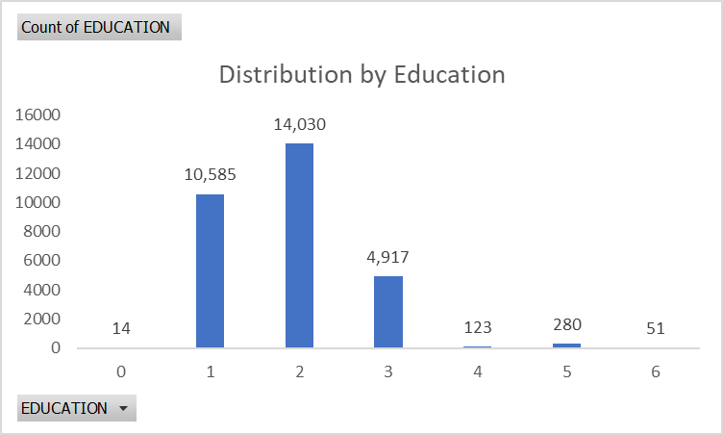
POTENTIAL ISSUES
FIXING THE DATA
FEATURE ENGINEERING
TREND DATA MISMATCH
DATA MISINFORMATION
Various data categories are small in volume and unnecessary, such as in Education and Marriage.
Will do feature engineering to decrease and group the number of categories.
Payment history does not follow the actual bill & payment numbers. Changes to due despite no billing, and vice versa
Will recreate the payment history based on the movements collected
Data provided is not intuitively, and could cause confusion. Billed amounts show negative and positive balances.
Definitions and numbers would be reviewed with client to get clarification
Notes:
Feature Engineering
There are variables that have too many categories, and those categories do not have a lot of observations. This may create noise as we build the model. Additionally if we either group or eliminate these variables, we would be able to improve the accuracy of our model.
Trend Data Mismatch
The history of past payment should show if previous payments were paid on time, if it was a revolving credit, or if it was late. Nevertheless, if you see the actual bill and payment numbers each month, the measurement given in the history of past payments does not reflect how the loan movements are done.
Data Misinformation
The variables of the database are confusing, and are not self explanatory. This provides a lot of confusion to what you are seeing and the analysis. Additionally, there are negative billed amounts, which do not seen to be “logical”. Clarification of the definitions and the numbers need to be done with the client.

Slide 14

DATA INSIGHTS

Slide 15
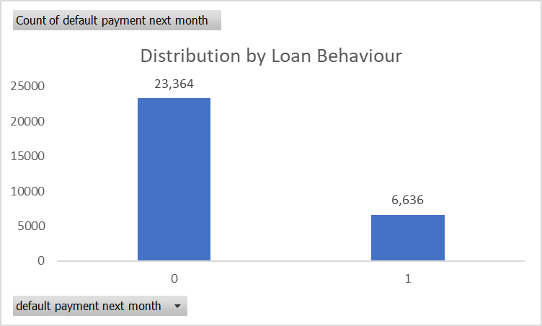
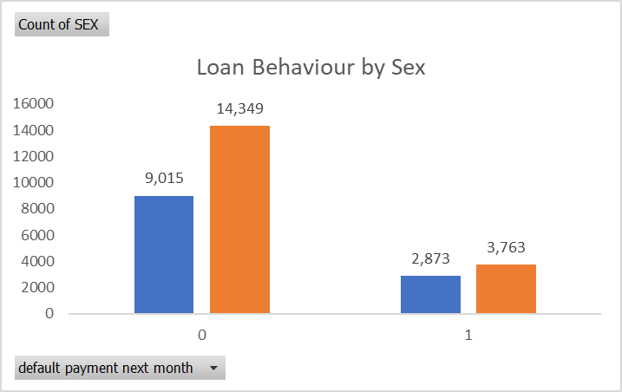
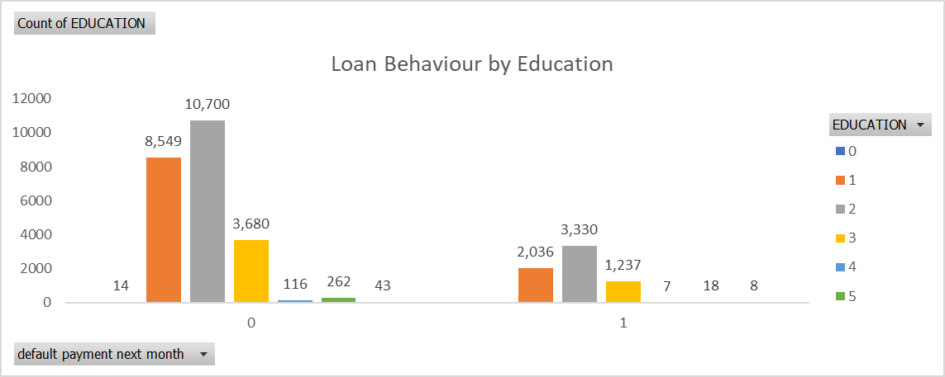
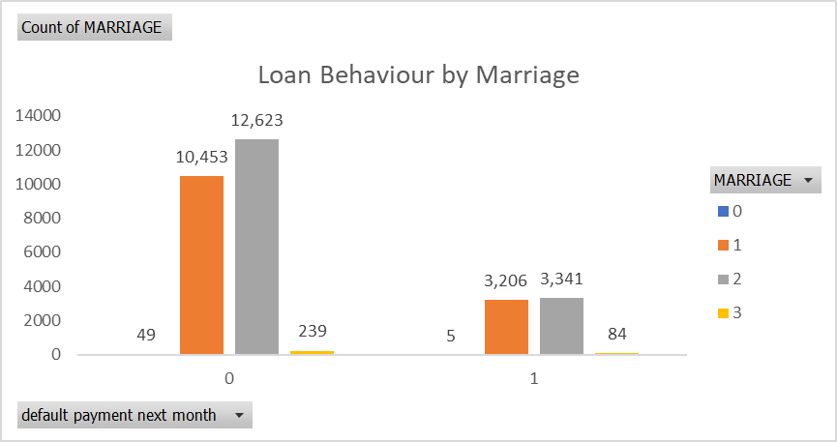
DESCRIPTIVE ANALYTICS
LOAN BEHAVIOUR SNAPSHOT
DISTRIBUTION BY LOAN BEHAVIOUR
LOAN BEHAVIOUR BY SEX: MALE DEFAULT MORE
LOAN BEHAVIOUR BY EDUCATION
LOAN BEHAVIOUR BY MARRIAGE
Male and more education result in higher delayed loans, marital status a non factor

Slide 16
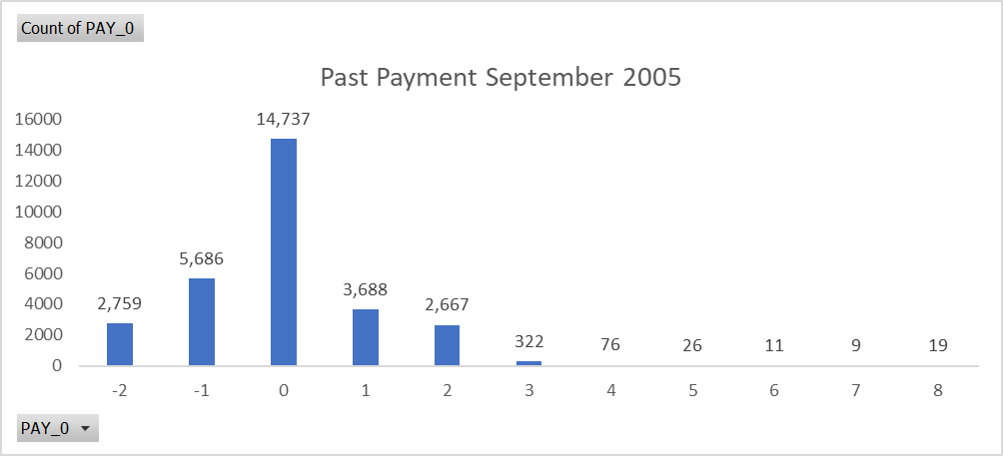
DESCRIPTIVE ANALYTICS
LOAN PAYMENT DELAYED TREND
DELAYED LOAN TREND
Over the last 6 months there has been an increase number of clients who are late in their loan payments
Over the last month there has been a big spike (2X) in the amount of cases
Investigate: was there any country, local or economical event that may have triggered this situation
Delayed loans have worsen over the last 6 months

